Slide 1
DEFFIE & HELMAN
KEY EXCHANGE ALGLORITHM

Slide 2
content
Define Deffie and Helman
History of the Algorithm
Application area of the algorithm
Mathematical expressions and steps
Drawback of the algorithm
sources for further reading

Slide 3
How can you securly share a symmetric
key over a communication channel
that is’t secure?

Slide 4
Deffiee and Helman Algorithm
It’s
key-exchange protocol that enables two parties communicating over public channel.
approprite bit length is 1024-2048
has two separate keys for encryption and
decryption.
used to exchange keys between senders
and recievers.
isn’t
encryption and decryption algorithm

Slide 5
History
in 1976 Whitfield Diffie Martin Helman published a paper that built haively on the perior work of Ralph Markle.
it describes what we know now as Deffie Helman key exchange.
it was one of the first practical examples of public key cryptography.
it solves symmetric key distribution problem.
brought cryptography new era.

Slide 6
Application Area
The Diffie-Hellman algorithm will be used to establish a secure communication channel.
DH can applicable around the following areas like online Banking,access Web mail,
logging into social media.
Protocols that are used to encrypt Data
TLS(SSL),IPsec,seure shell.

Slide 7
Mathematics Behind
Diffie-Hellman Key Exchange

Slide 8
In practice the shared encryption key relies on such complex concepts as Modular Exponentiation, Primitive Roots and Discrete Logarithm problems.
Let’s see though is we can explain the Diffie-Hellman algorithm with no complex mathematics.

Slide 9
A Difficult One-Way Problem
The first thing we require is a simple real-world operation that is easy to DO but hard to UNDO.
  You can ring a bell but not unring one.
  Toothpaste is easy to squeeze out of a tube but famously hard to put back in.

Slide 10
Let’s get math
We will rely on the formula below being an easy problem one direction and hard in reverse.
prime numbers are easy to multiply but hard to devide.
s = g^{n} mod p
  Easy: given g, n, & p, solve for s
  Hard: given s, g, & p, solve for n
And the property of
  g^{a*b} mod p = g^{b*a} mod p

Slide 11
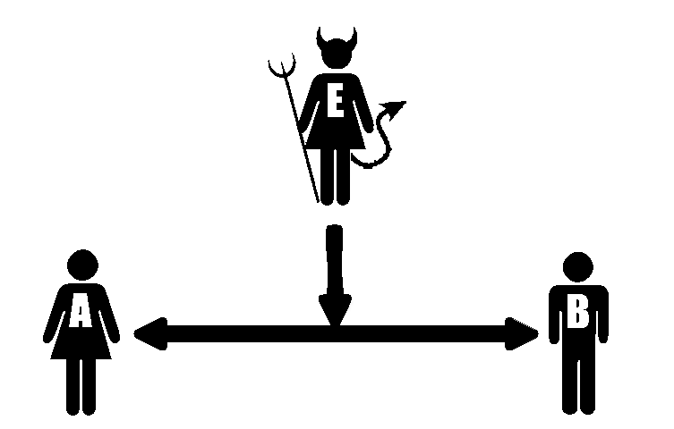
Alice & Bob with Eve listening wish to unsecure communicate

Slide 12
Step 1 –Publicly shared information
Alice & Bob publicly agree to a large prime number called the modulus, or p.
Alice & Bob publicly agree to a number called the generator, or g, which has a primitive root relationship with p.
In our example we’ll assume
  p = 17
  g = 3
Eve is aware of the values of p or g.

Slide 13
Step 2 – Select a secret key
Alice selects a secret key, which we will call a.
Bob selects a secret key, which we will call b.
For our example assume:
  a = 54
  b = 24
Eve is unaware of the values of a or b.

Slide 14
Step 3 – Combine secret keys with public information
Alice combines her secret key of a with the public information to compute A.
  A = gª mod p
  A = 3⁵⁴ mod 17
  A = 15

Slide 15
Step 3 – Combine secret key with public information
Bob combines his secret key of b with the public information to compute B.
  B = g^{b} mod p
  B = 3⁵⁴ mod 17
  B = 16

Slide 16
Step 4 – Share combined values
Alice shares her combined value, A, with Bob. Bob shares his combined value, B, with Alice.
Sent to Bob
  A = 15
Sent to Alice
  B = 16
Eve is privy to this exchange and knows the values of A and B

Slide 17
Step 5 – Compute Shared Key
Alice computes the shared key.
  s = (B mod p)ª mod p
  s = g^{b*a} mod p
  s = 3^{54*24} mod 17
  s = 1
Bob computes the shared key.
  s = (A mod p)ª mod p
  s = g^{a*b} mod p
  s = 3^{24*54} mod 17
  s = 1

Slide 18
Alice & Bob have a shared encryption key, unknown to Eve
Alice & Bob have created a shared secret key, s, unknown to Eve
In our example s=1
The shared secret key can now be used to encrypt & decrypt messages by both parties.

Slide 19
Drawback of DH algorithm
Deffie and Helman allgorithm is vulnerable
for man in the middle attack, logjim attacks & bruttforce attack.
it doesn’t provide Authentication-you can’t
validate who you are commmunicating.
Best practice
it needs algorithm of Authentication with
digital certeficate and signature.

Slide 20
source for further reading
Advane your skill with these link further:
Diffie-Hellman Key Exchange Explained
https://www.cryptool.org
https://www.simplilearn.com

Slide 21
Thank You!

